Slide 1
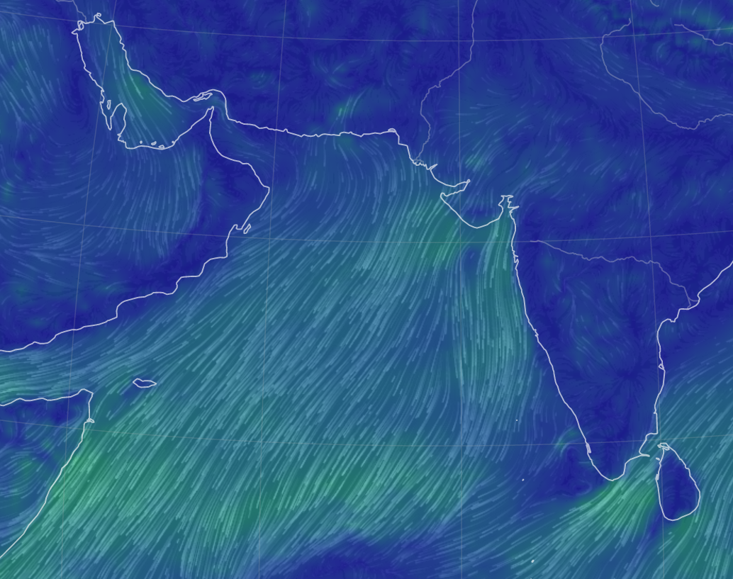
Using image machine learning algorithms to study changing upwelling patterns in the Arabian Sea
Jacob T. Zikan
Dartmouth College, Hanover, NH
Jack Bryne Scholar, Department of Mathematics
Dr. E. Eli Holmes
NOAA Fisheries & University of Washington, Seattle, WA USA
Winter wind map in the N Indian Ocean

Slide 2
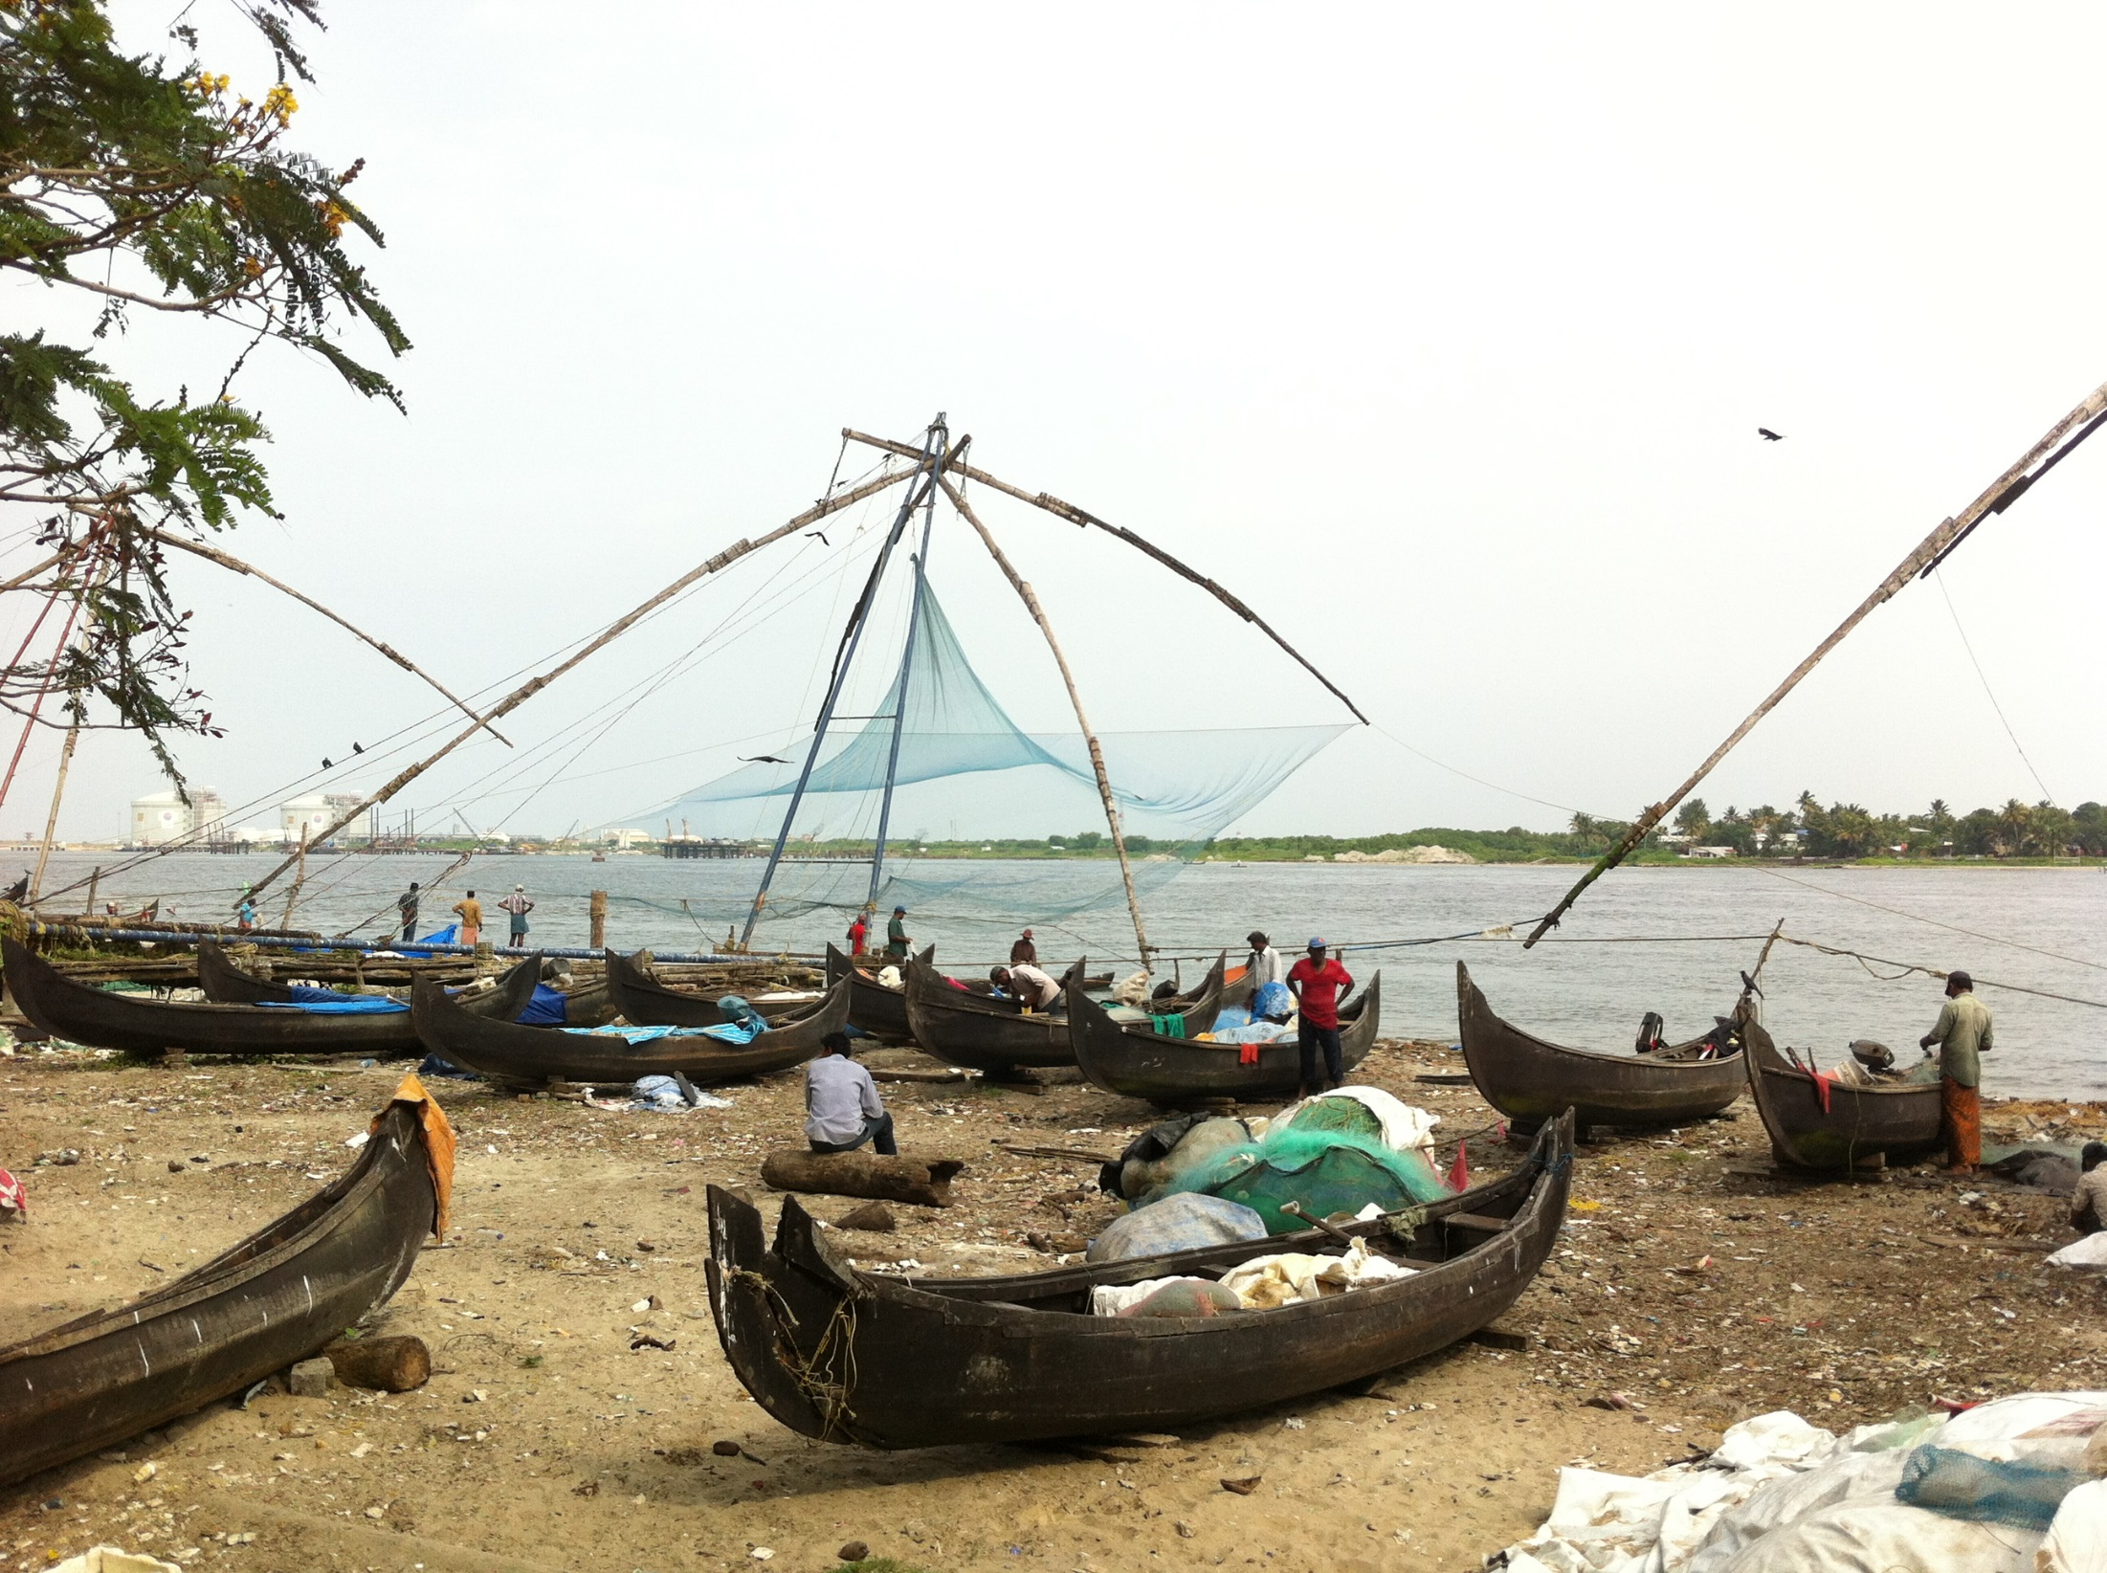
This was an undergraduate research project within a larger research project: Development of Predictive Capabilities for Marine Fisheries and Harmful Algal Blooms in Indian Seas (NOAA Fisheries/India Ministry of Earth Sciences)
Kochi, India (E Holmes)

Slide 3
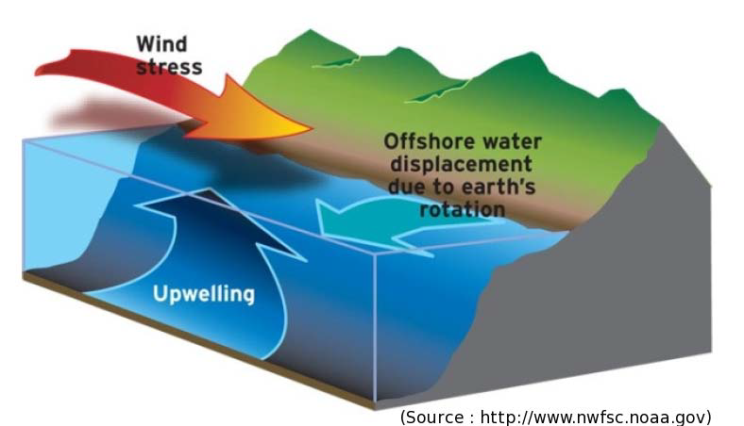
Objective
Coastal upwelling is a process by which winds create surface water displacement that causes cold, nutrient rich, water to come from the ocean floor to the surface

Slide 4
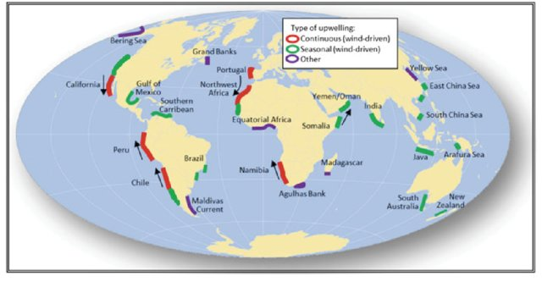
The South east Arabian Sea (SEAS) is one of world’s major upwelling zones
SEAS Coastal upwelling zone driven by summer monsoon
Kämpf J., Chapman P. (2016) The Functioning of Coastal Upwelling Systems. In: Upwelling Systems of the World. Springer, Cham. https://doi.org/10.1007/978-3-319-42524-5_2

Slide 5
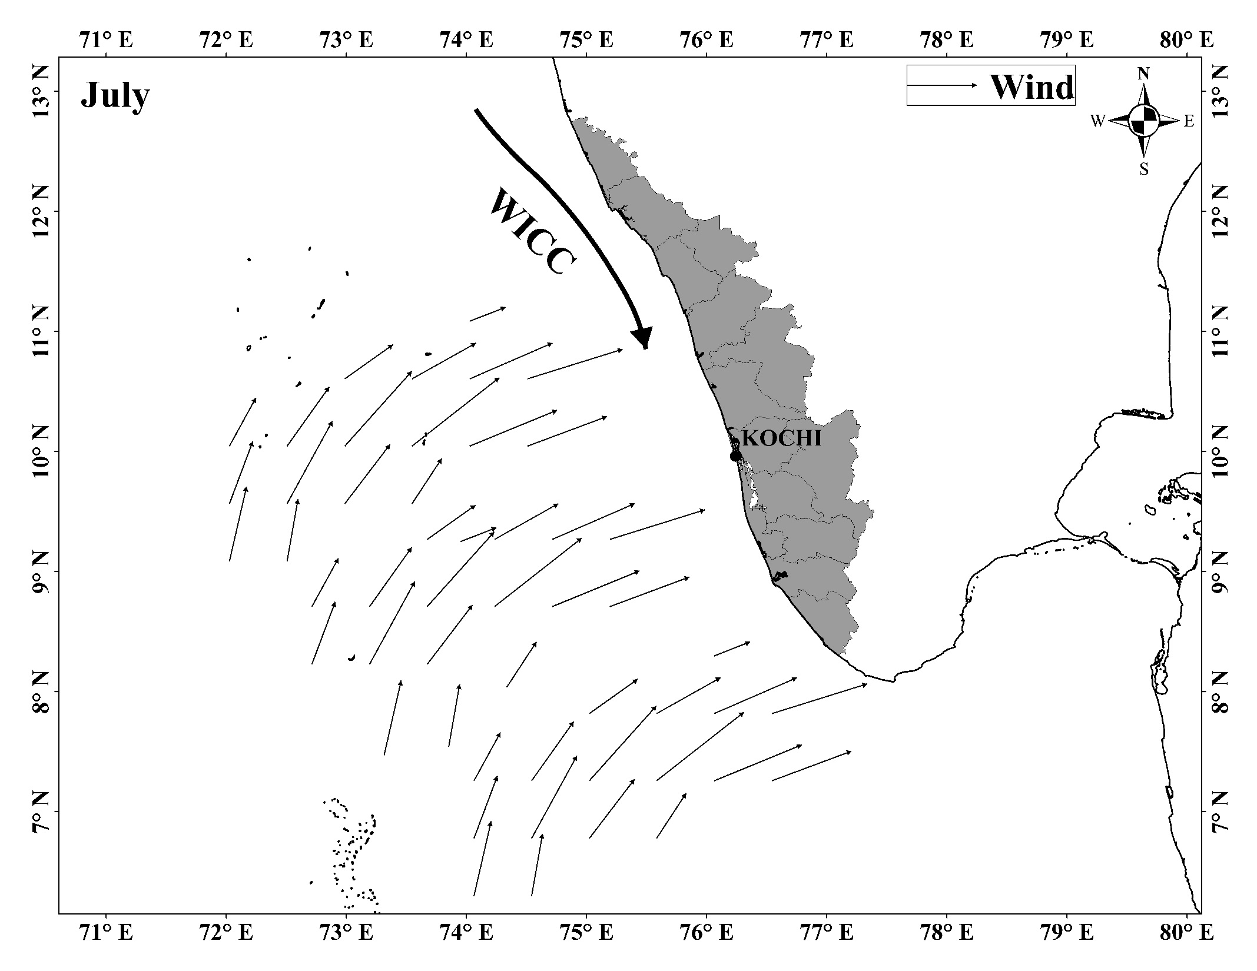
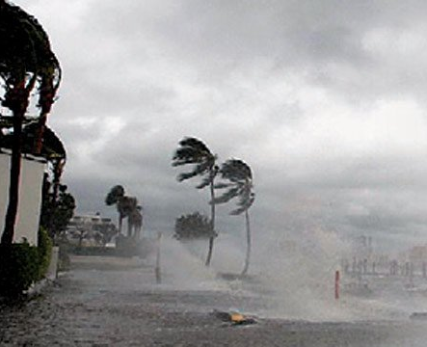
The South east Arabian Sea (SEAS) upwelling system is unique because it is seasonal and driven by the summer monsoon that brings high winds driving into the coast
June to September
coastal current
Southern
India
wind
upwelling zone

Slide 6
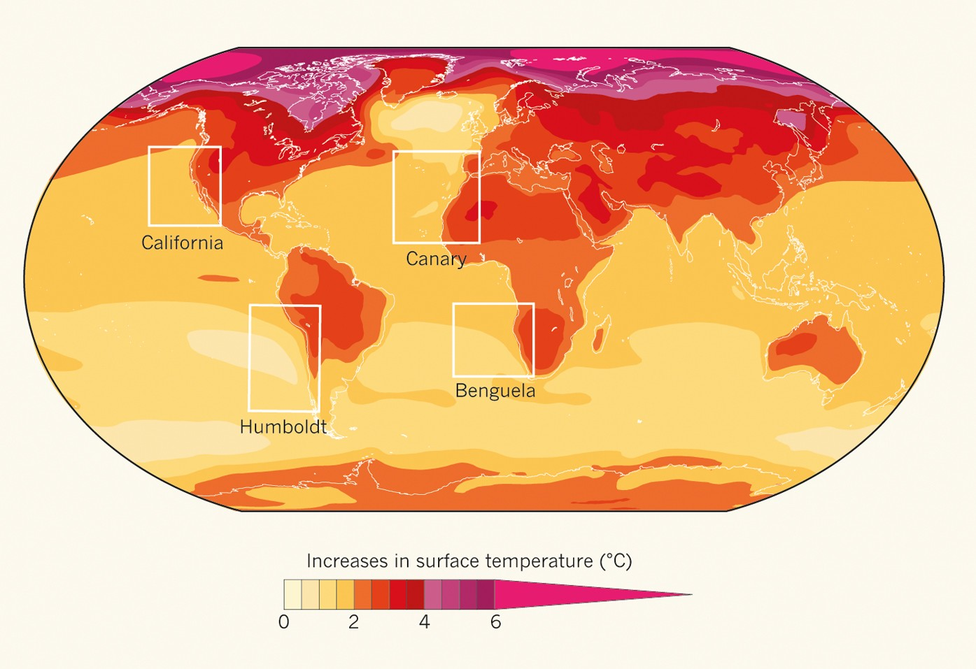
The South east Arabian Sea (SEAS) is warming quickly. With this ocean climate change comes changes in upwelling patterns
Di Lorenzo, E. The future of coastal ocean upwelling. Nature 518, 310–311 (2015). https://doi.org/10.1038/518310a
Projected warming between now and 2050
Arabian Sea
Can unsupervised machine learning help us understand how the upwelling spatial and temporal pattern is changing?

Slide 7
One way is by looking at the sea surface temperature. The cold water is upwelled from the bottom. This picture shows strong upwelling.
How Do we Quantify an Upwelling Pattern?
Cold water
Notes:
How do people quantify upwelling normally:
Ekman mass transport. Estimating the transport of seawater which is perpendicular and away from the coast. Compute that by looking at surface winds.
2nd main way: Looking at sea surface temperature. Signal of the cold water coming up from the bottom. Specifically looking at a pattern which is similar to what you are seeing on the image here. Look for signal where water is really cold off the coast, and much warmer farther off the coast.

Slide 8
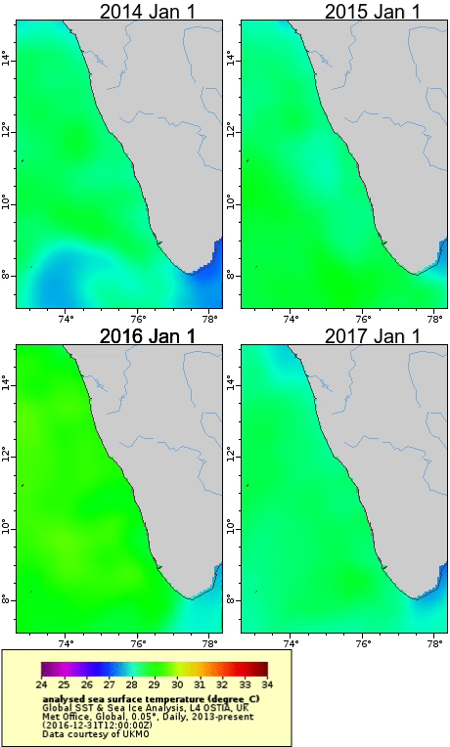
These patterns change year to year
This movie shows the SST pattern over 4 years.
How can we quantify these patterns to understand if the spatial pattern of upwelling is changing?

Slide 9
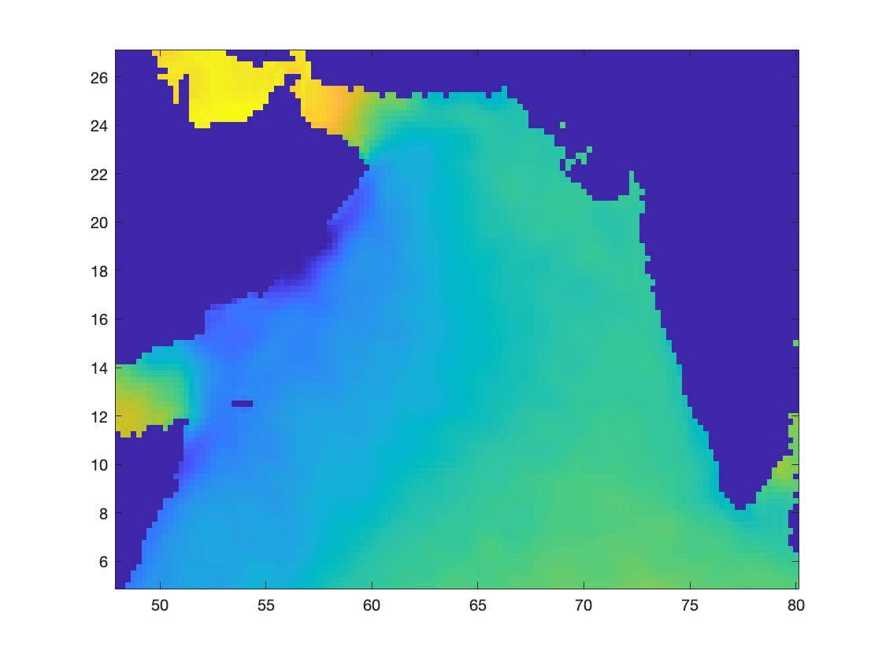
Monthly SST Data (1979-2019)
European Centre for Medium-Range Weather Forecasts, Climate Change Service
August 1st, 1979
ERA5: Hersbach, H., Bell, B., Berrisford, P., et al. The ERA5 global reanalysis. Quarterly Journal of the Royal Meteorological Society. 2020; 146: 1999–2049. https://doi.org/10.1002/qj.3803
Notes:
SST data
Reanalysis Data ERA5 monthly 2d Surface
http://apdrc.soest.hawaii.edu/erddap/griddap/hawaii_soest_d124_2bb9_c935.html
This is a global reanalysis product based on remote-sensing data. On a 0.25 degree grid.
Produced by
European Centre for Medium-Range Weather Forecasts, Climate Change Service
I used data starting in January 1979 going until July 2020. I used data taken at one month intervals, as I felt that would accurately capture the patterns, without overcrowding the algorithm

Slide 10
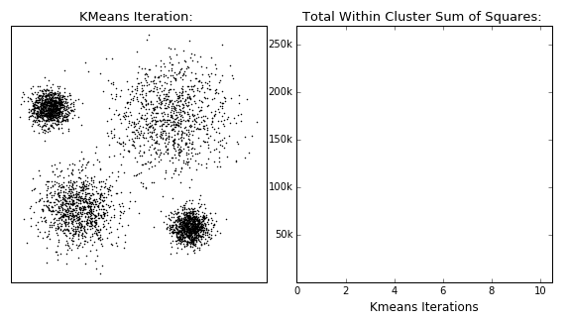
K-Means Process
Assign points into groups according closest centroid
Calculate mean of points in a group
Move centroid to said mean
Repeat
Notes:
Credit: https://dashee87.github.io/data%20science/general/Clustering-with-Scikit-with-GIFs/
- In machine learning there are two main subsets, those being supervised and unsupervised learning. Supervised learning is used to predict something which is known. In supervised learning the 'right answers' are given to train the algorithm, for example training an algorithm to use a list environmental factors to try to predict population abundance. While this type of learning has predictive power, you also need to train it on data with that abundance given. Unsupervised learning is mostly used to find structure in the unknown. In unsupervised learning, something does not have right answers, and so the methods look for patterns within the data. Take for example social networking algorithms which try to find friends to recomend to you. There is no database of the global friendgroups that can be used to learn on; The algorithm is simply finding patterns within the data. This is the same idea I used in my data. There is no database of ‘correct’ sea surface temperature patterns. The algorithm simply finds patterns.
- K-means is an unsupervised learning algorithm which groups data in vectorspace. The goal of the algorithm is to minimize the sum of least mean squares of each point to the centroid/group they are assigned to.
Machine learning grouping algorithm
Used to find clusters within data
Iterative process to move closer to groups
I will go into how the algorithm works a bit more just so people have a bit more understanding of how these centroids are found.
Based on the number of groups desired(n), the algorithm will randomly initialize the positions of n centroids, which will then be moved over an iterative process to minimize the distance of datapoints to their closest centroid. In this image on the screen, the number of groups is 3. Each point will then be assigned to the centroid it is closest to.
The mean of each group will then be calculated.
Then each centroid will be moved to that mean, and
Then the process repeats again. The points are reassigned to groups again, but this time using the new centroid positions, and so on. This process repeats until the centroids converge at a point where there generational movement is negligible.

Slide 11
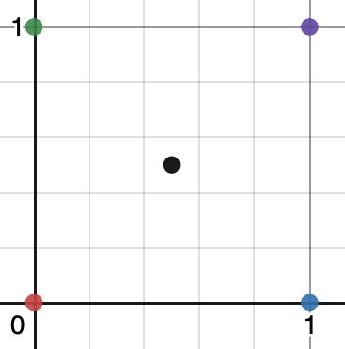
Mapping Images to Space
2 Pixel Image
X
Y
Notes:
Image a 2 pixel image. You can assign each pixel a dimension (X,Y) and map that into 2 dimensional (R²) space.
Now imagine if you had more pixels you could map those to other dimensions. So if you had a third pixel you could map that to 3d, and after that we cant visualize it really well, but you can think you can map those to different dimensions.

Slide 12
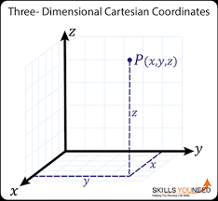
Mapping Images to Space
3 Pixel Image
X
Y
Z
Notes:
Credit: https://www.intmath.com/vectors/6-3-dimensional-space.php
So if you had a third pixel you could map that to 3d, and after that we cant visualize it really well, but you can think you can map those to different dimensions.

Slide 13
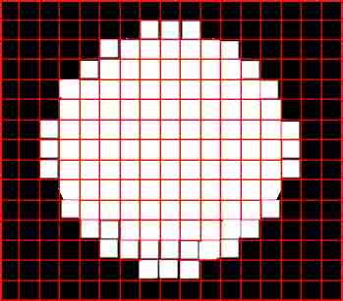
Mapping Images to Space
P Pixel Image
Unravel each image into a list of its pixel values
Each pixel in the image is a parameter
Therefore, each image can be represented as a vector in R^{p}
Group images by clustering them in R^{p} space using K-Means Algorithm
…
Notes:
Now how does this work with images. Well, an image is simply a collection of pixels, each pixel having a value assigned to it (that value in my data was not the color value, but rather the temperature at that position). If you unravel an image into a list of those values, then your image is now represented as a p-dimentional vector, with p being the number of pixels.
Then, when the images are in vector form K-means can be run to get centroids in Rp
These centroids can then be reconstructed into images, by reversing the process done to unravel the images.

Slide 14
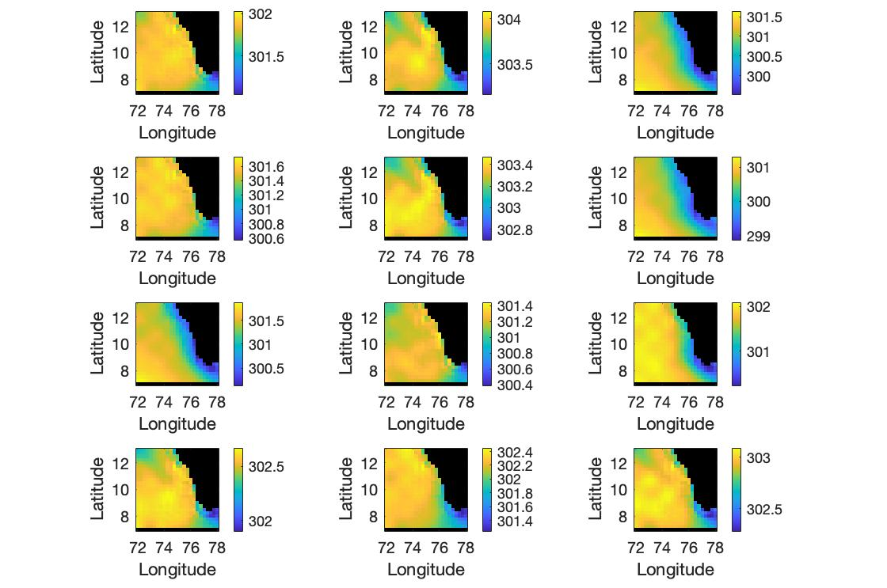
Clusters Selected by K-Means Algorithm
Notes:
- And with that, you can create centroid images. These images are not temperature images which have every happened, = but rather mean values of the groups of temperature forms k-means found within the data.
- The ‘non-normalized’ will become much more clear when I go to the next slide, but it just means that the grouping algorithm was done on the data without any modifications.
The number I chose was 12, which was chosen as it seemed a significantly large number to capture the major groupings of the data over time. The groups are scaled differently, so two groups which may look similar may be spanning different ranges, and thus would group differently. That is why several groups look similiar
We can see some interesting patterns in these groupings. Noting groups (3,6,7), or (1,4,11) or even (2,5,10,12), one can see there are a couple base shapes/patterns, but these patterns show up with temperature shifts of the mean of the entire sea.
MORE ANALYSIS

Slide 15
Organizing the Clusters: Upwelling Patterns
Notes:
- And with that, you can create centroid images. These images are not temperature images which have every happened, = but rather mean values of the groups of temperature forms k-means found within the data.
- The ‘non-normalized’ will become much more clear when I go to the next slide, but it just means that the grouping algorithm was done on the data without any modifications.
The number I chose was 12, which was chosen as it seemed a significantly large number to capture the major groupings of the data over time. The groups are scaled differently, so two groups which may look similar may be spanning different ranges, and thus would group differently. That is why several groups look similiar
We can see some interesting patterns in these groupings. Noting groups (3,6,7), or (1,4,11) or even (2,5,10,12), one can see there are a couple base shapes/patterns, but these patterns show up with temperature shifts of the mean of the entire sea.
MORE ANALYSIS

Slide 16
Organizing the Clusters: Unform Temperatures
Notes:
- And with that, you can create centroid images. These images are not temperature images which have every happened, = but rather mean values of the groups of temperature forms k-means found within the data.
- The ‘non-normalized’ will become much more clear when I go to the next slide, but it just means that the grouping algorithm was done on the data without any modifications.
The number I chose was 12, which was chosen as it seemed a significantly large number to capture the major groupings of the data over time. The groups are scaled differently, so two groups which may look similar may be spanning different ranges, and thus would group differently. That is why several groups look similiar
We can see some interesting patterns in these groupings. Noting groups (3,6,7), or (1,4,11) or even (2,5,10,12), one can see there are a couple base shapes/patterns, but these patterns show up with temperature shifts of the mean of the entire sea.
MORE ANALYSIS

Slide 17
Organizing the Clusters: Cold Northern Tongue
Notes:
- And with that, you can create centroid images. These images are not temperature images which have every happened, = but rather mean values of the groups of temperature forms k-means found within the data.
- The ‘non-normalized’ will become much more clear when I go to the next slide, but it just means that the grouping algorithm was done on the data without any modifications.
The number I chose was 12, which was chosen as it seemed a significantly large number to capture the major groupings of the data over time. The groups are scaled differently, so two groups which may look similar may be spanning different ranges, and thus would group differently. That is why several groups look similiar
We can see some interesting patterns in these groupings. Noting groups (3,6,7), or (1,4,11) or even (2,5,10,12), one can see there are a couple base shapes/patterns, but these patterns show up with temperature shifts of the mean of the entire sea.
MORE ANALYSIS

Slide 18
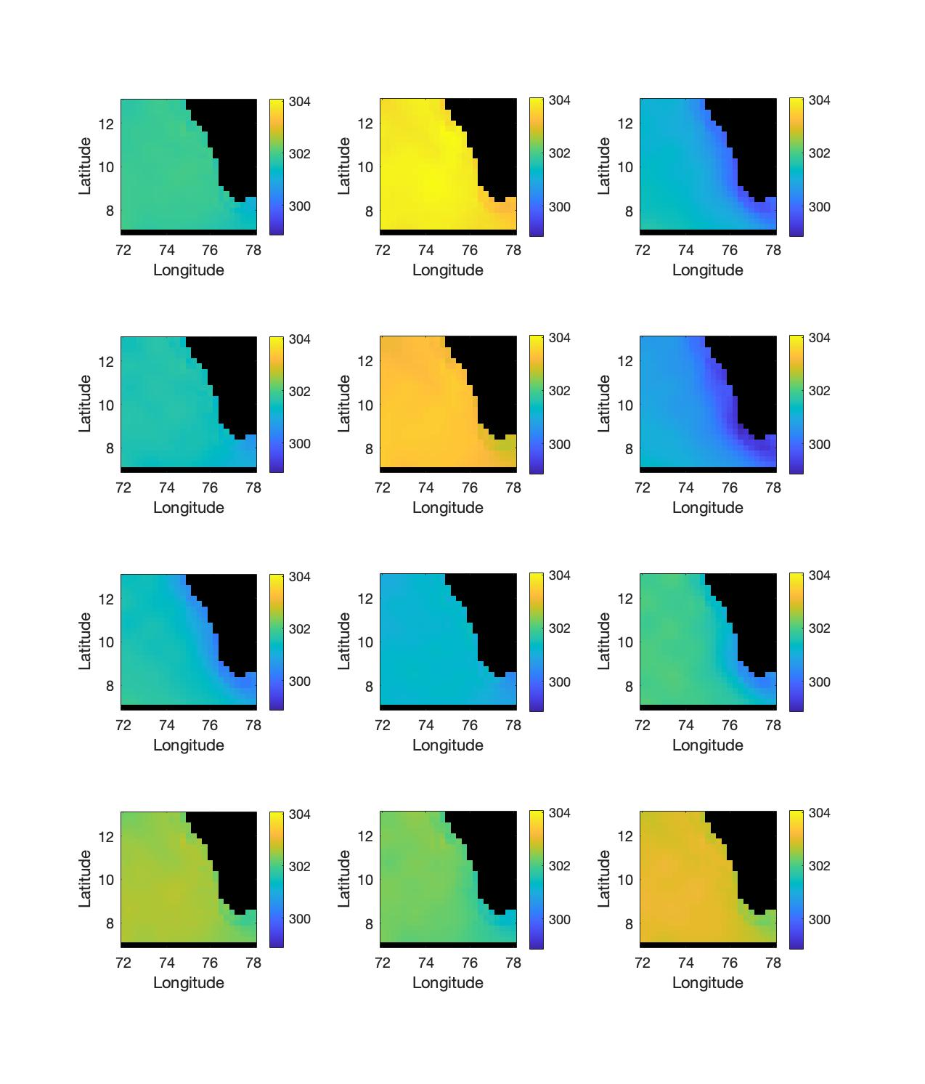
Clusters on Same Temperature Scale

Slide 19
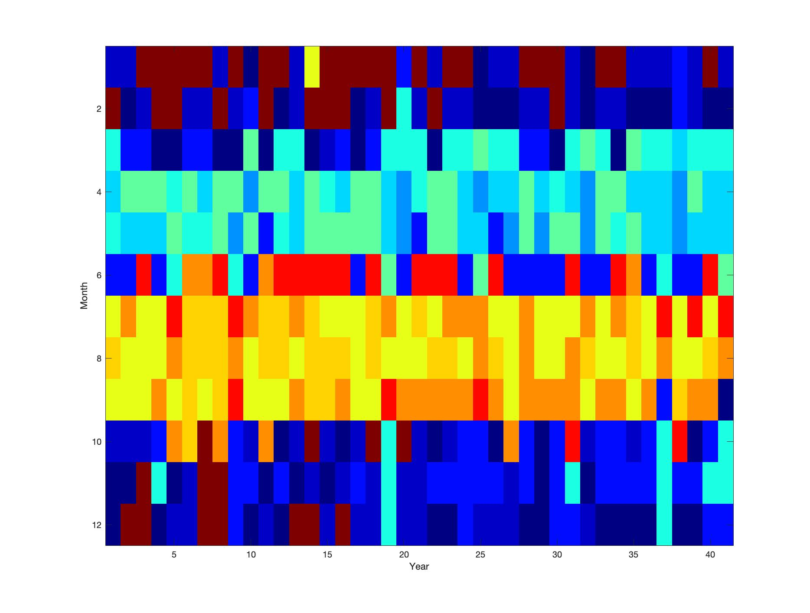
Seasonal and Yearly Pattern
January
MONTH
[ UPWELLING ]
December
YEAR (from 1979)

Slide 20
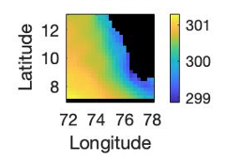
Summer Monsoon = Upwelling = Strong coastal cold zone

Slide 21
Shorter Upwelling Seasons

Slide 22
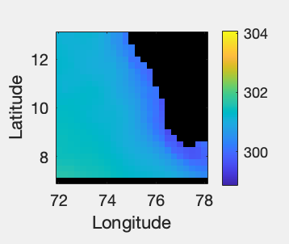
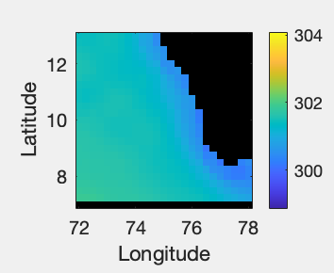
The Sept pattern did not change but the water warmed
Notes:
Even though water is getting warmer, still seeing upwelling patterns in the differential

Slide 23
The Pattern of March Temperature Changing
Notes:
Even though water is getting warmer, still seeing upwelling patterns in the differential

Slide 24
Conclusions
From preliminary study
K-Means was capable of detecting image clusters that make sense
Upwelling Seasons seem to be changing (Shorter and warmer)
Shows promise for evaluating how spatial pattern changes

Slide 25
Next Steps (Upwelling Patterns)
New types of data (Wind, ect…)
Analyze daily data and assign to groups
Questions: Is the stability of the upwelling breaking down?

Slide 26
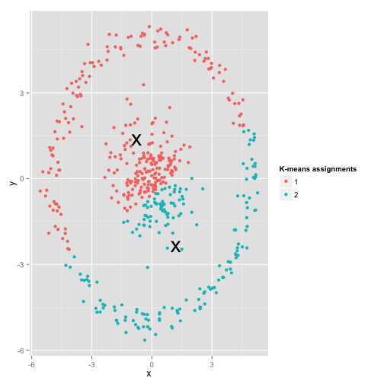
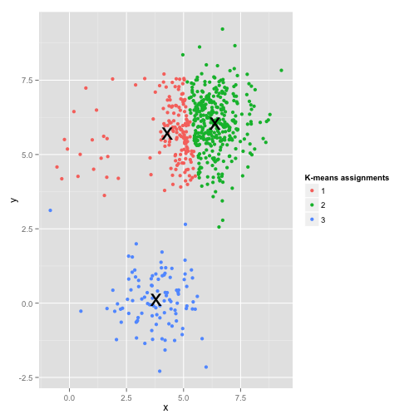

Next Steps (Algorithms)
Using different grouping algorithms
DBSCAN, Hierarchical clustering…
Anomaly detection algorithms
Neural networks
Notes:
Heiarchical Clustering: https://dashee87.github.io/data%20science/general/Clustering-with-Scikit-with-GIFs/
DBSCAN: https://www.kdnuggets.com/2020/04/dbscan-clustering-algorithm-machine-learning.html
1) There are a couple next steps one could take in the use of K-Means grouping algorithms. Firstly, it could be useful to run the grouping algorithm using data only from certain months, such as the months which are usually in monsoon season for example. This would allow one to analyze groups more closely for those month blocks you see in the heatmap.
2) Also there is more work which can be done looking at changing the number of groups to something lower than 12, to even higher.
3) There is a lot which can be explored by using more advanced grouping algorithms. These might be able to see irregularly shaped groups, and deal with groups of unequal size better, and thus give more accurate or informative groupings.
This could be very important in this data as the upwelling groups are small, but important, and may be getting lost due to the large-group bias in K-means.
4) Finally, these same grouping algorithms could be applied to all types of remote sensing data, It could group wind speed maps, or really any sort of data with the same structure.

Slide 27
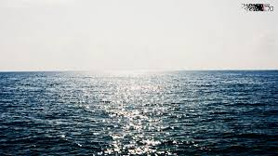
(Image)
jacob.t.zikan.23@Dartmouth.edu
Notes:
Thank you very much. I’ll be happy to take questions

Slide 28

Notes:
Heiarchical Clustering: https://dashee87.github.io/data%20science/general/Clustering-with-Scikit-with-GIFs/
DBSCAN: https://www.kdnuggets.com/2020/04/dbscan-clustering-algorithm-machine-learning.html
1) There are a couple next steps one could take in the use of K-Means grouping algorithms. Firstly, it could be useful to run the grouping algorithm using data only from certain months, such as the months which are usually in monsoon season for example. This would allow one to analyze groups more closely for those month blocks you see in the heatmap.
2) Also there is more work which can be done looking at changing the number of groups to something lower than 12, to even higher.
3) There is a lot which can be explored by using more advanced grouping algorithms. These might be able to see irregularly shaped groups, and deal with groups of unequal size better, and thus give more accurate or informative groupings.
This could be very important in this data as the upwelling groups are small, but important, and may be getting lost due to the large-group bias in K-means.
4) Finally, these same grouping algorithms could be applied to all types of remote sensing data, It could group wind speed maps, or really any sort of data with the same structure.

